Slide 1
Global SmartPhone 360
-A smart phone recommendation application
Dec,2023

Slide 2
Our Team
1. B. SAI ROHIT
2. P. VINEETHA
3. ROHIT BANSODE
4. S. GAYATHRI

Slide 3
Objective
The objective of our project global smartphone 360 web application is to assist users in choosing the most suitable device based on their preferences, budget, and other specific requirements.
In this, we are using many AWS services like EC2,RDS,DMS,S3,Glue,Athena,Quicksight to create web applications.
For designing and implementing the smartphone recommendation platform we are using the flask which is a web framework in python.

Slide 4





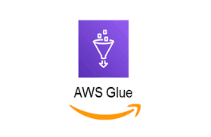



ARCHITECTURE
User

Slide 5
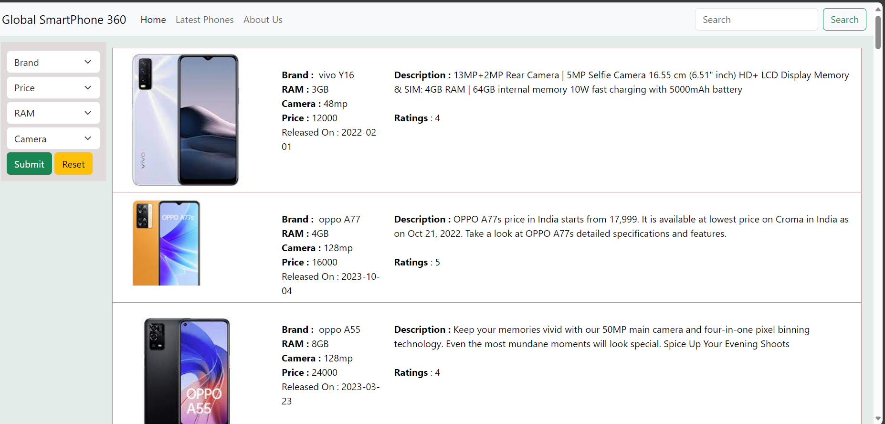
Dashboard of our Website

Slide 6
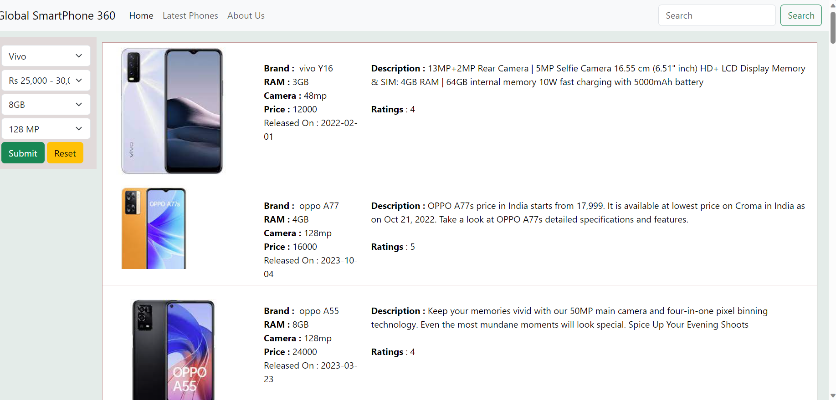
Preferences by users’

Slide 7
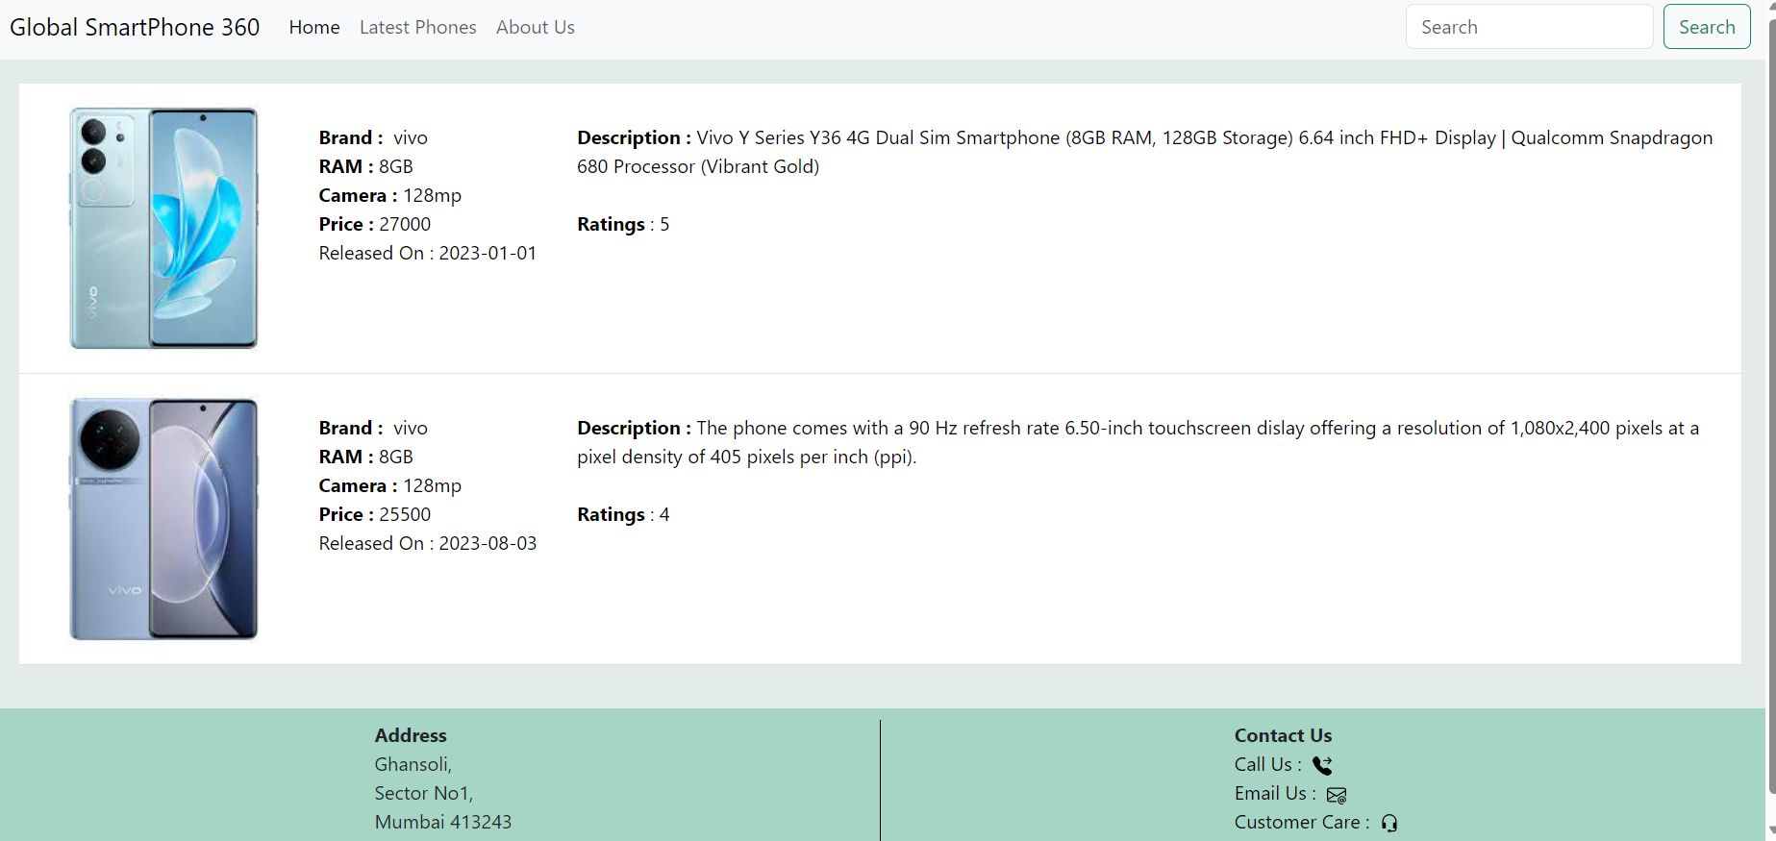
Filtered Records

Slide 8
Flask
Flask is a lightweight web framework for Python that simplifies the process of building Web applications. Flask is based on the Werkzeug WSGI toolkit and the Jinja2 template engine.
Werkzeug
Werkzeug is a WSGI toolkit that implements requests, response objects, and utility functions. This enables a web frame to be built on it. The Flask framework uses Werkzeug as one of its bases. since werkzeug is only for development we use Gunicorn for production under WSG
Nginx :Nginx is an HTTP and reverse proxy server. It provides HTTPS server capabilities and is mainly designed for maximum performance and stability.

Slide 9
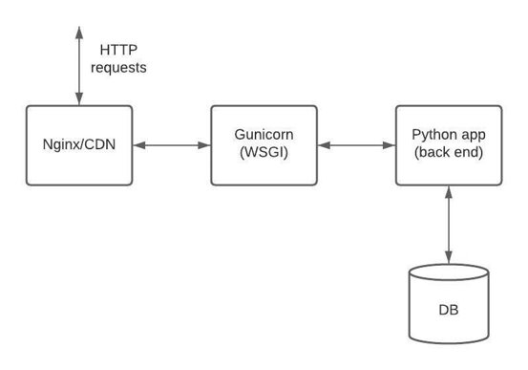
Jinja2 : It is a popular template engine for Python. A web template system combines a template with a specific data source to render a dynamic web page.

Slide 10
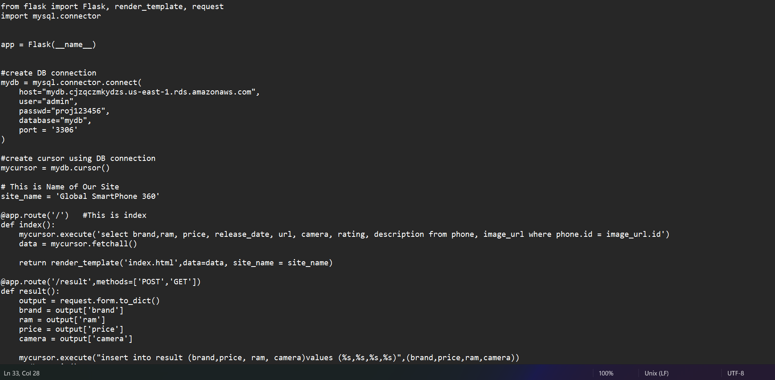
Web Application using Python Flask

Slide 11
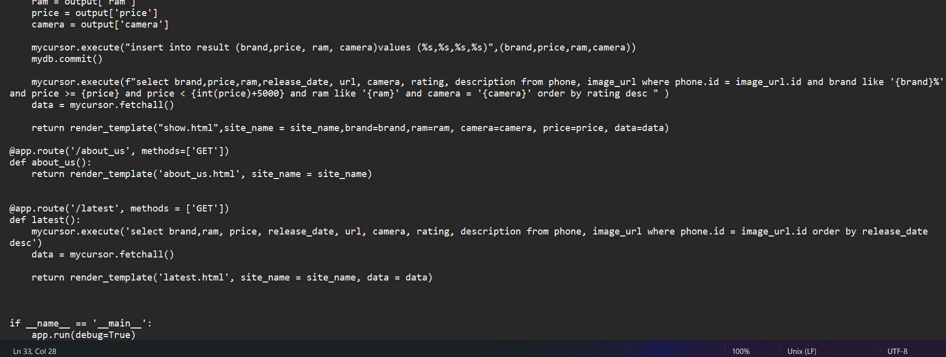
…continued

Slide 12
AMAZON EC2
EC2 means Elastic compute cloud.
Amazon EC2 is a web service provided by Amazon Web Services (AWS) that allows users to rent virtual servers in the cloud.
It provides scalable computing capacity and is commonly used for hosting applications, websites, and other services.

Slide 13
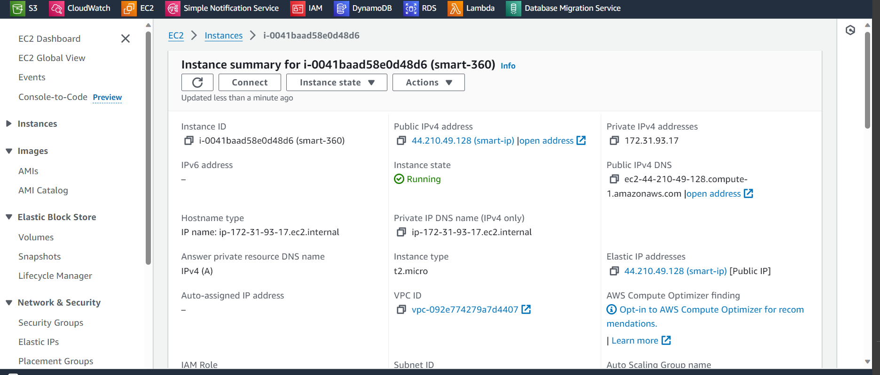

Slide 14
RDS(Relational Database Service)
Amazon Relational Database Service(Amazon RDS) is a collection of managed services that makes it simple to set up, operate, and scale databases in the cloud.
Cost-efficient, Scalable, Easy to setup, Backup/Restore.
It supports multiple database engines like Amazon Aurora, PostgreSQL, MySql, Oracle DB and SQL Server.

Slide 15
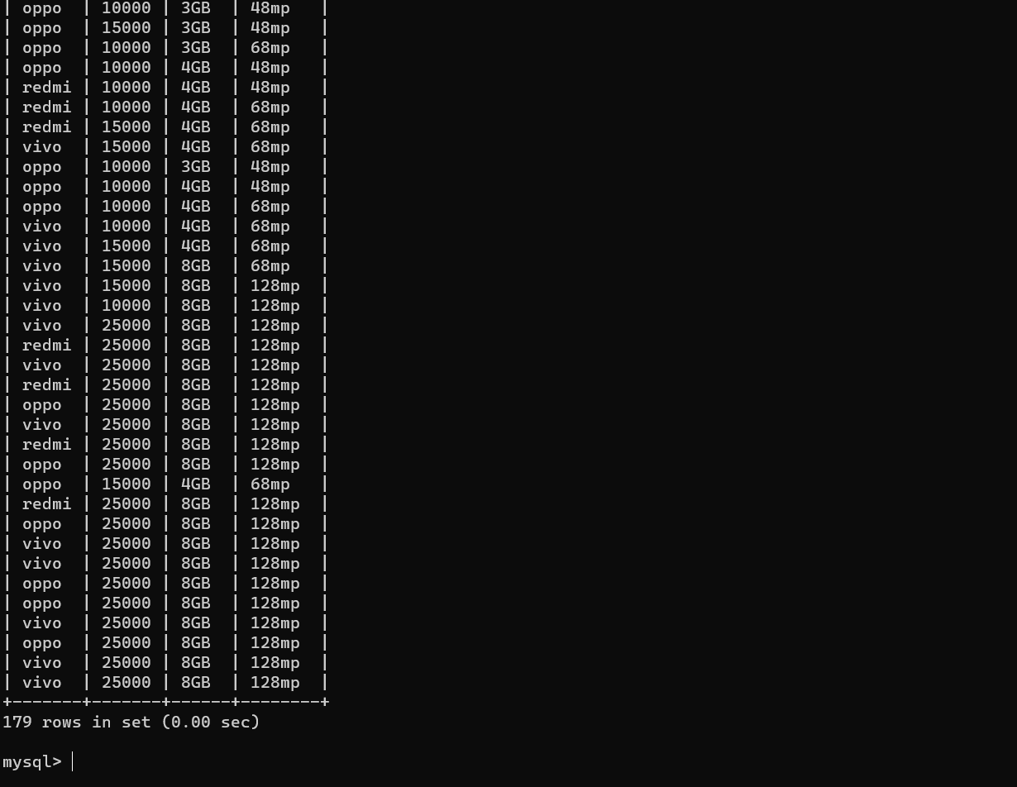
Reflection of Users’ Data Into RDS(MySQL) in CLI

Slide 16
DATABASE MIGRATION SERVICE(DMS)
AWS Database Migration Service (AWS DMS) is a cloud service that makes it possible to migrate relational databases, data warehouses, NoSQL databases, and other types of data stores. You can use AWS DMS to migrate your data into the AWS Cloud or between combinations of cloud and on-premises setups
With AWS DMS, you can discover your source data stores, convert your source schemas, and migrate your data.

Slide 17
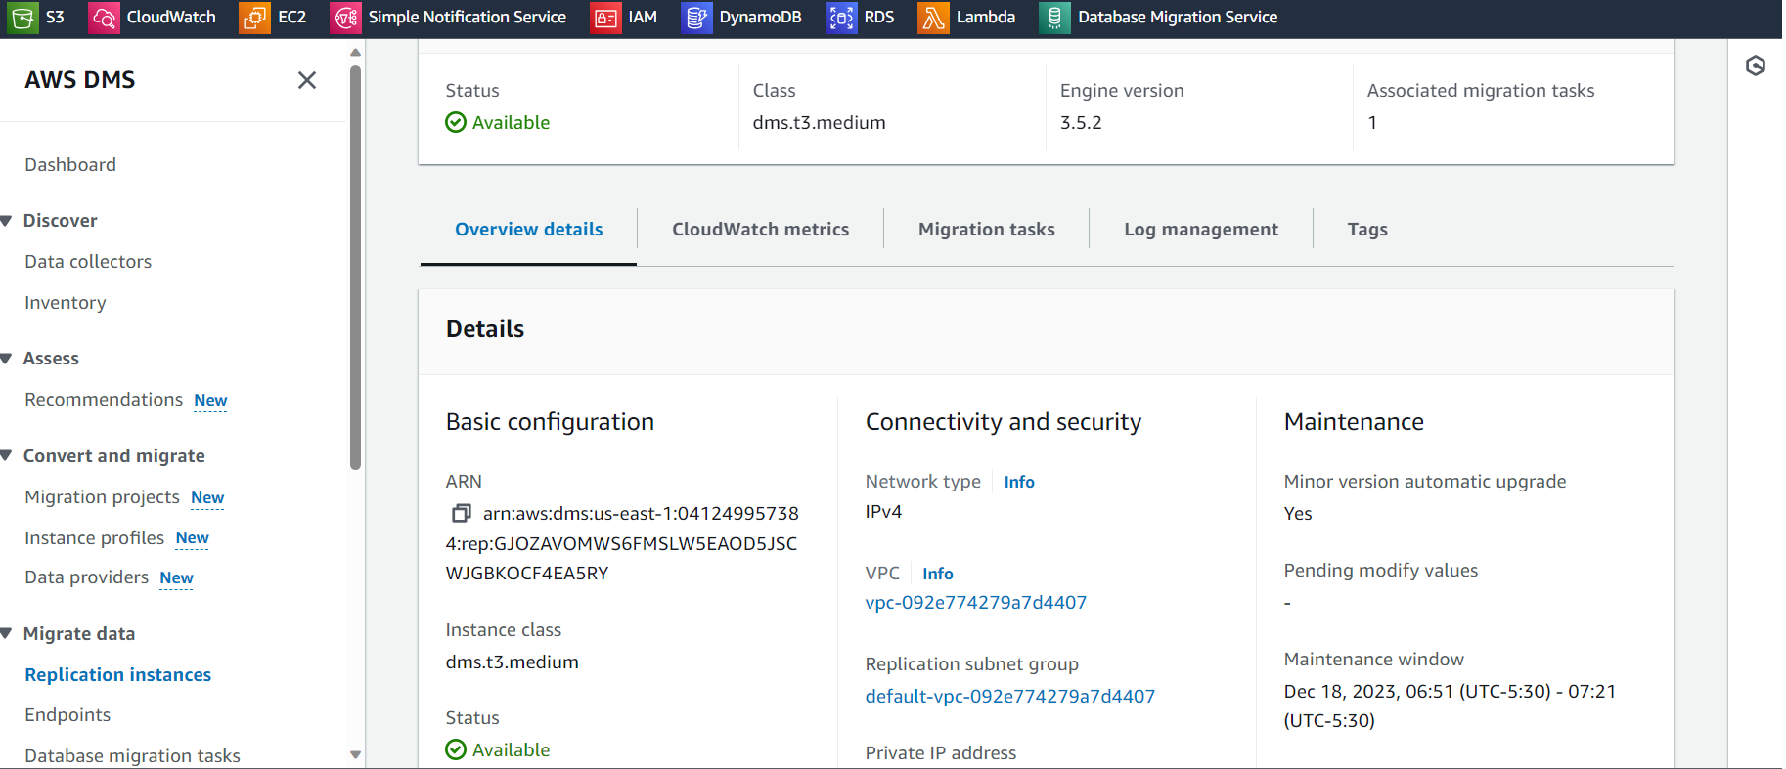
Creating replication instance in DMS

Slide 18
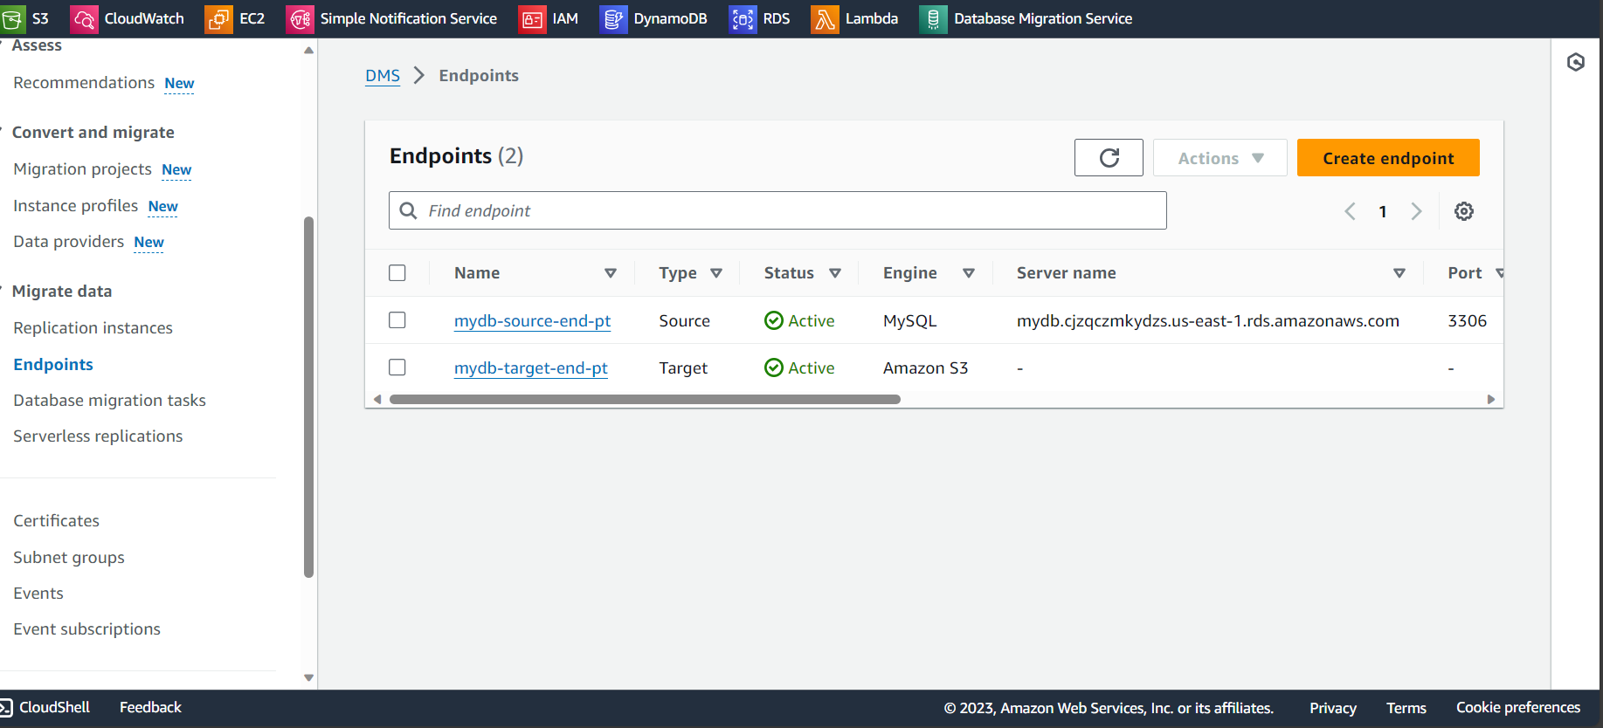
Moving the Data from RDS to S3 using AWS DMS
Creating source-point(RDS-MySQL) and end-point(S3)

Slide 19
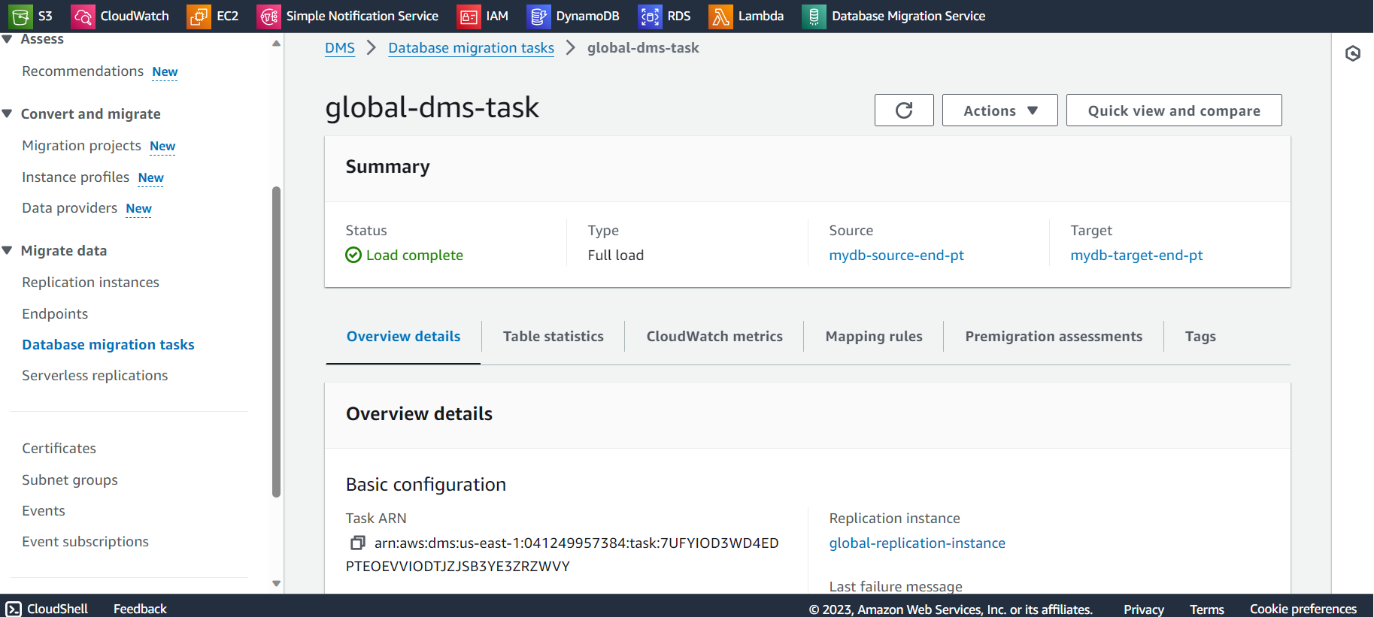
Creating Database Migration Task

Slide 20
Amazon S3
Amazon S3 is a scalable object storage service provided by Amazon Web Service.
S3 is designed for storing and retrieving any amount of data from anywhere on the web.
It uses a simple key-based object storage model, where data is organized into buckets and each object in a bucket is identified by a unique key.
S3 provides high durability and availability.

Slide 21
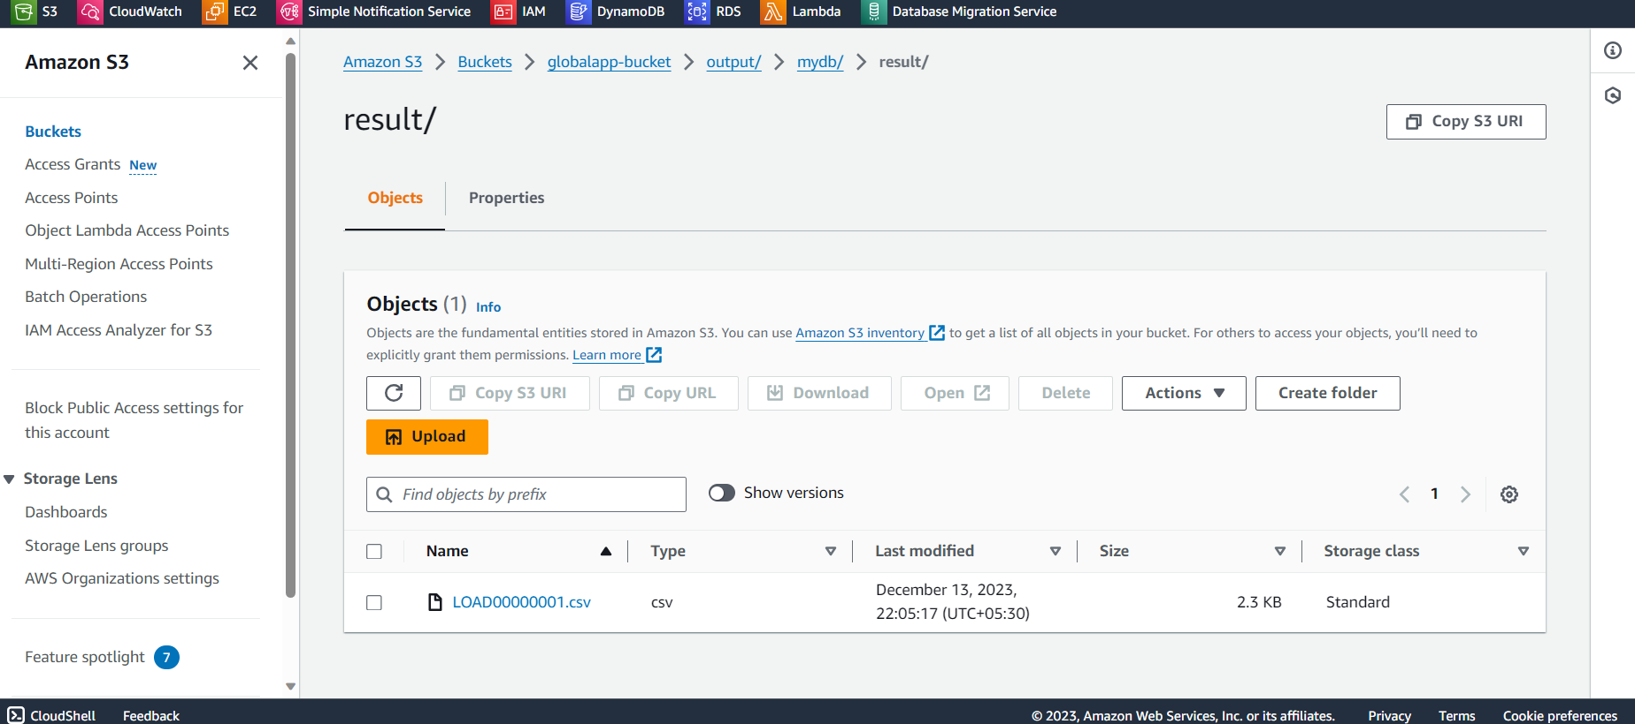
Csv file is being reflected in S3 bucket

Slide 22
Amazon Glue
AWS Glue is a cloud based ETL (extract, transform, and load) service provided by Amazon
Web Services.
AWS Glue is a fully managed ETL service that makes it simple and cost effective to
categorize your data.
AWS Glue simplifies the process of preparing and loading data for analysis.
Crawler: Crawler is the primary method used by AWS Glue users. A crawler can crawl
multiple data stores in a single run. Upon completion, the crawler creates or updates one or more tables in your Data Catalog. Extract, transform, and load (ETL) jobs that you define in AWS Glue use these Data Catalog tables as sources and targets. The ETL job reads from and writes to the data stores that are specified in the source and target Data Catalog tables.

Slide 23
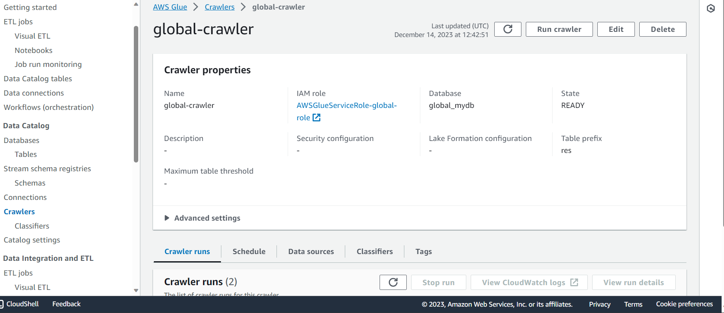
Fetching csv file in AWS Glue using AWS Crawler

Slide 24
Amazon Athena
Amazon Athena is an interactive query service provided by Amazon Web Services that
enables us to analyze data stored in Amazon S3 using standard SQL queries.
Athena integrates with AWS Identity and Access Management(IAM) for access control.
Athena is used to process logs, perform data analytics, and run interactive queries.
Athena scales automatically – executing queries in parallel – so results are fast, even with
large datasets and complex queries.

Slide 25
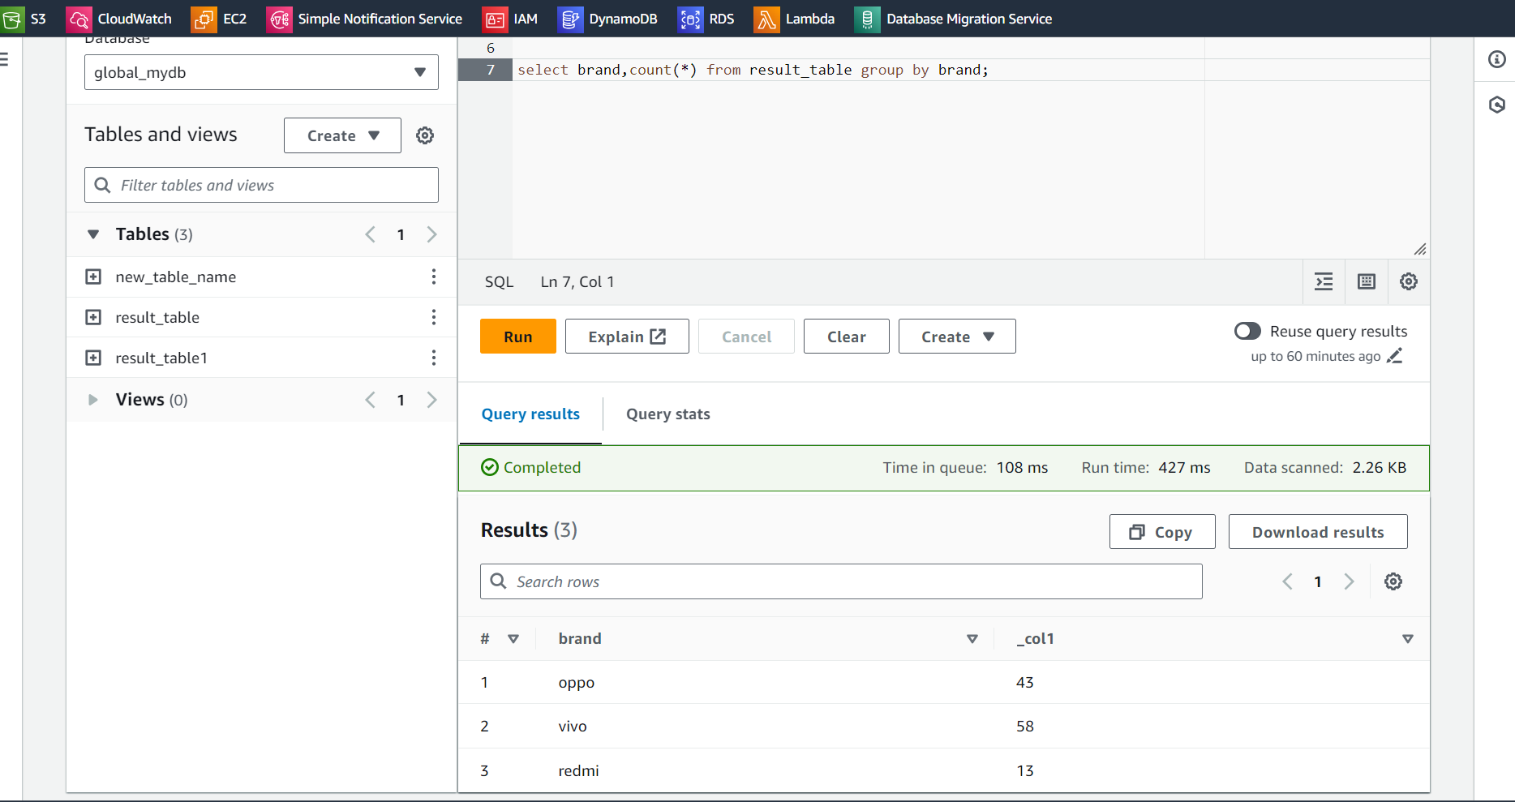
Querying in AWS Athena

Slide 26
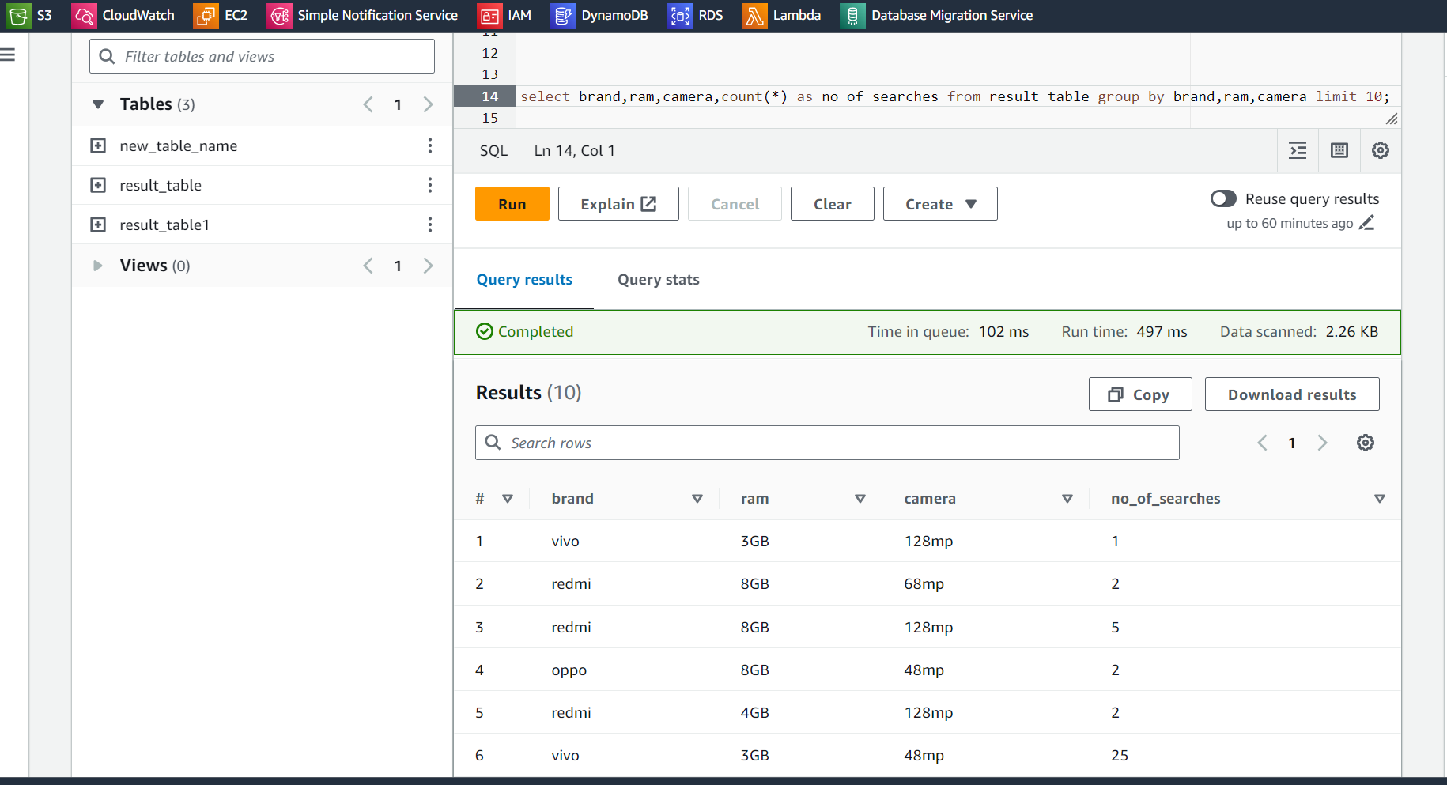
…continued

Slide 27
Amazon Quick Sight
Amazon Quick Sight is a cloud-based business intelligence(BI) service provided by
Amazon Web Services.
It offers a range of visualization options to create interactive and insightful
dashboards. Users can create charts, graphs, and other visual elements to represent
data.
Quick Sight uses the Super-Fast, Parallel, In-memory Calculation Engine(SPICE) to
provide fast and responsive data visualizations.

Slide 28
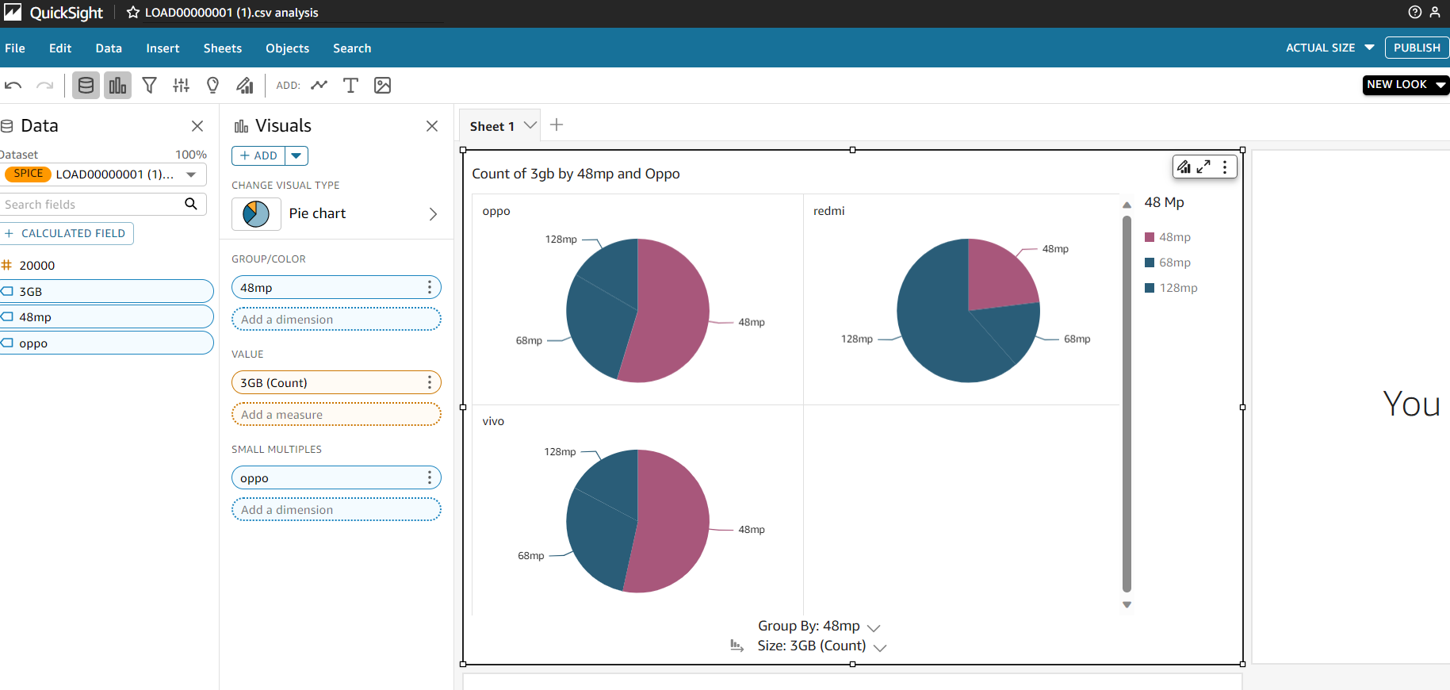
Data Visualization using AWS Quick Sight:

Slide 29
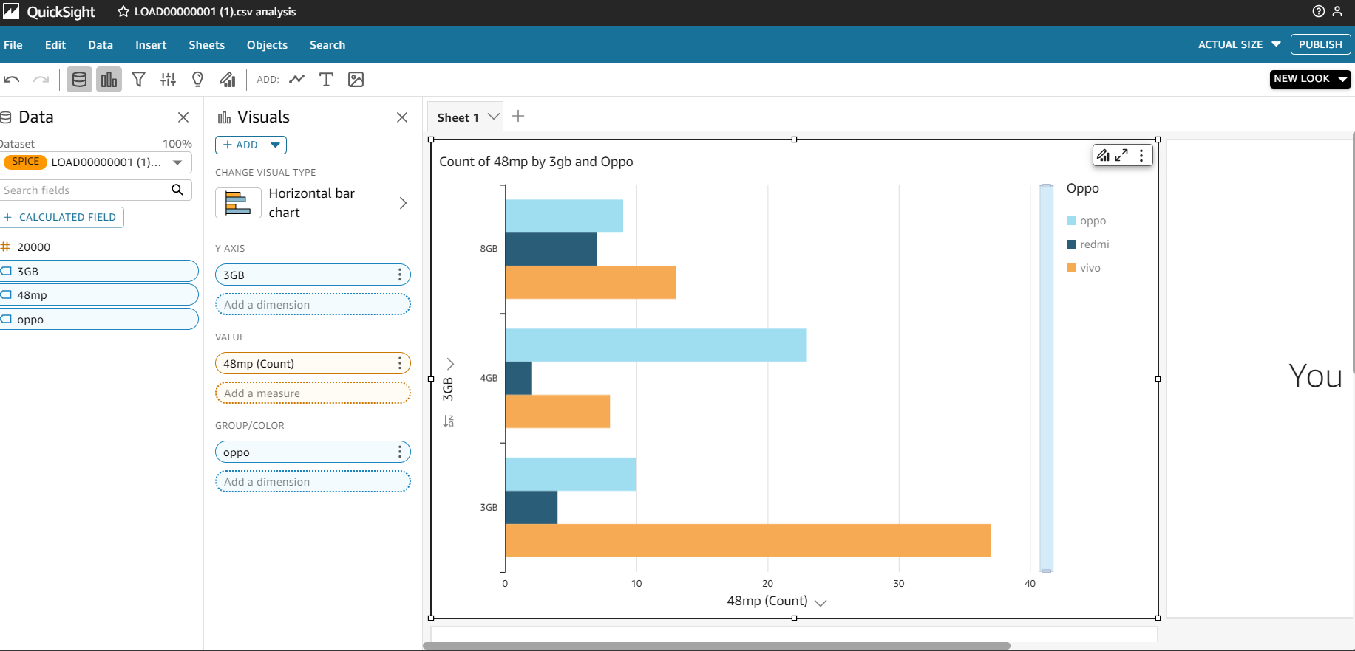
Horizontal Bar Graph

Slide 30
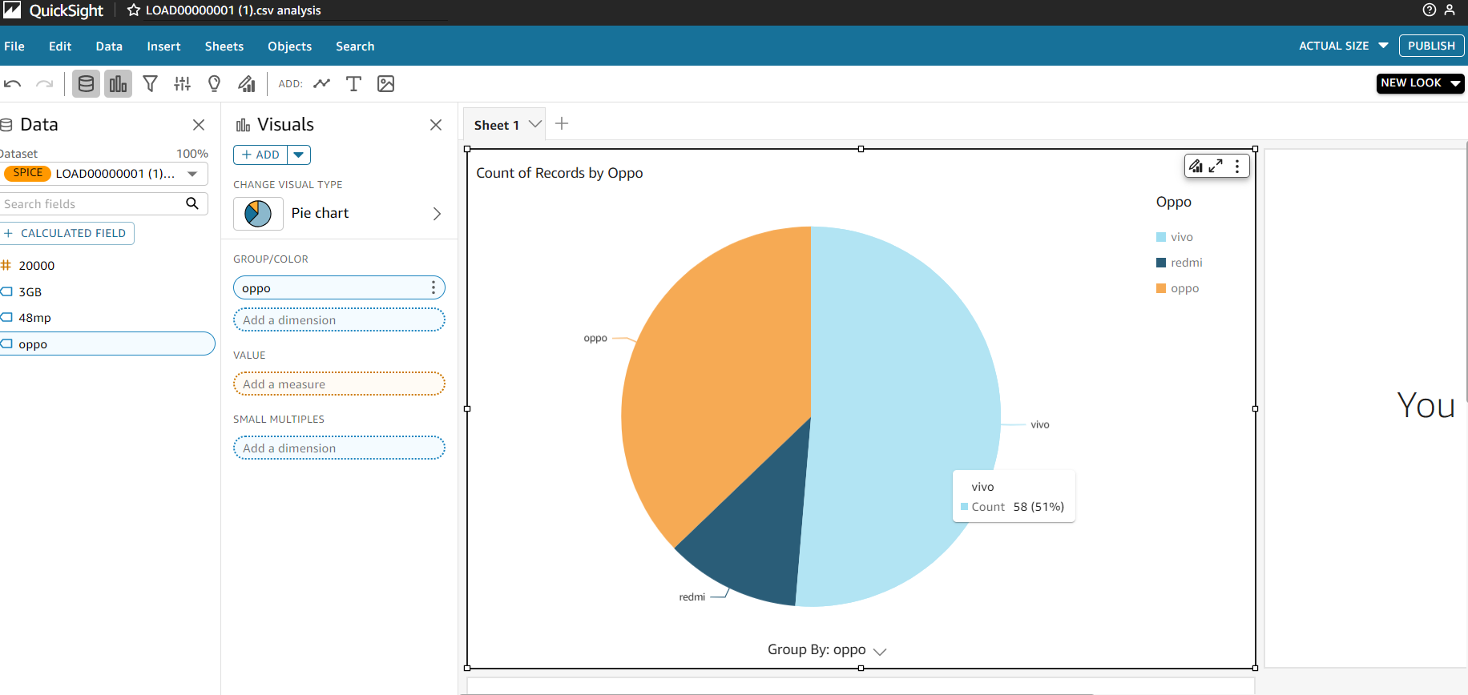
Pie Chart

Slide 31
FUTURE SCOPE
The future scope of our project holds promising opportunities for innovation and growth in smart phones industry.
Integrate predictive analytics to anticipate user needs, enabling proactive recommendations and staying ahead of emerging trends in the smartphones market.
It helps users choose the best mobiles based on their choices without wasting their time browsing the internet.
The analysis of the users’ data can be utilized to make efficient business decisions.

Slide 32

ANY QUESTIONS

Slide 33
Thank You

